Slide 1
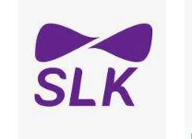

https://localhost:4200/
Presentation
On
Online Clothes Shopping
By : Shilpa Konappa
Date:7/4/2022

Slide 2
https://localhost:4200
CLOSH

Slide 3
Abstract
Now a days the life style of people is different people feel uncomfortable and time consuming for going crowded markets.
So online clothes shopping is saves lot of times.
Shoppers can visit closh application from the comfort of their house and shop by sitting in front of computer.

Slide 4
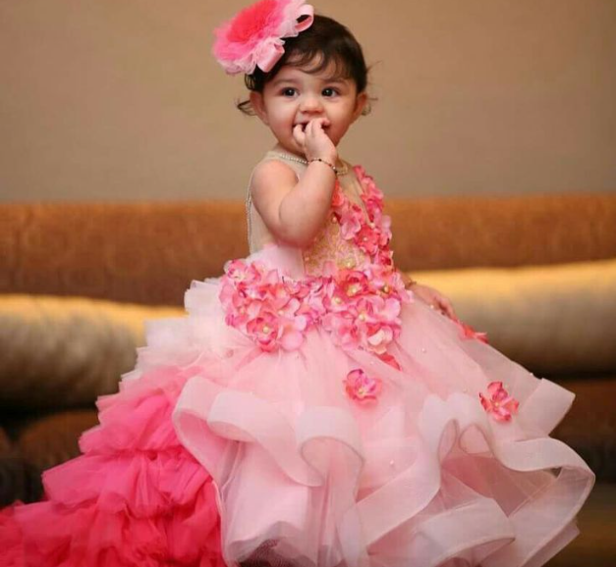
Contents
1
Technologies used
2
Flow Chart
3
Login Page
4
Forgotpassword Page
5
SignUp Page
6
Home Page
7
Cart Page
8
Payment Page

Slide 5
Technologies Used
Front End – Angular,Bootstrap(Visual Studio Code)
Back End – Spring Framework,MySQL Database

Slide 6
Start
Flow Chart
User
Login
No
Signup
Yes
View Product
Add to cart
Online Gpay
No
Yes
Payment
Logout
COD

Slide 7
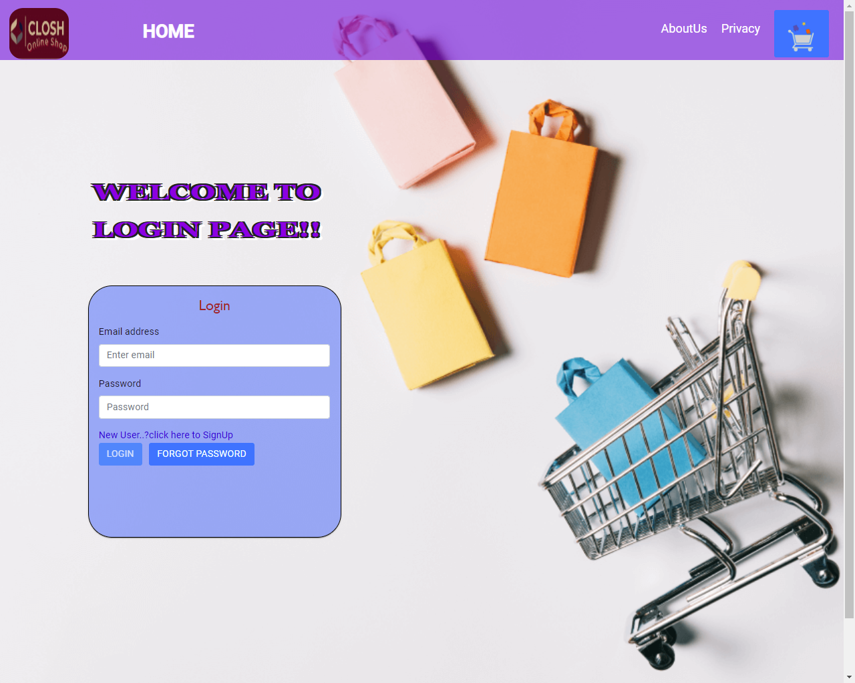
Login Page

Slide 8
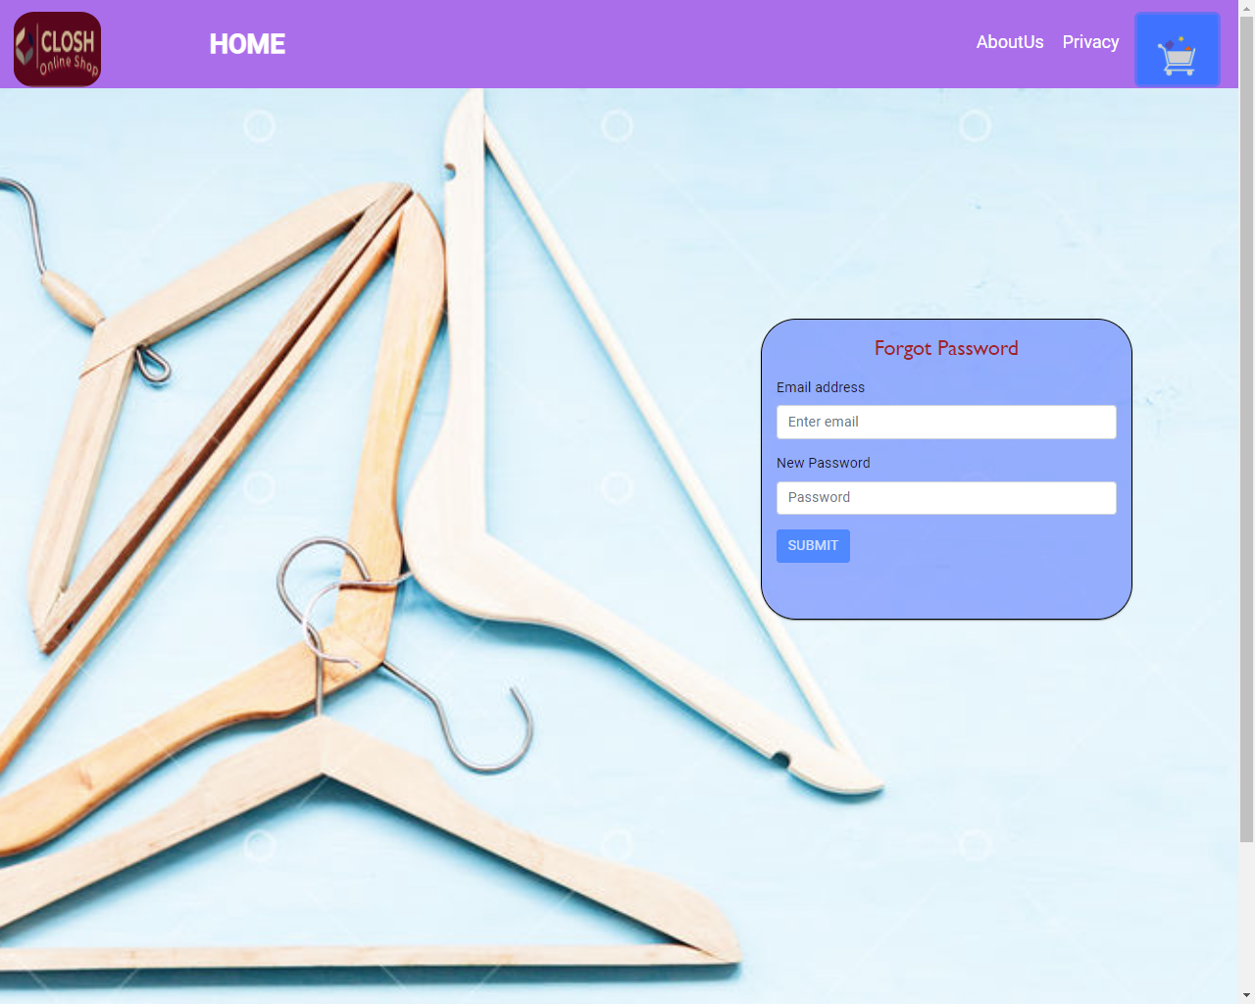
ForgotPassword Page

Slide 9
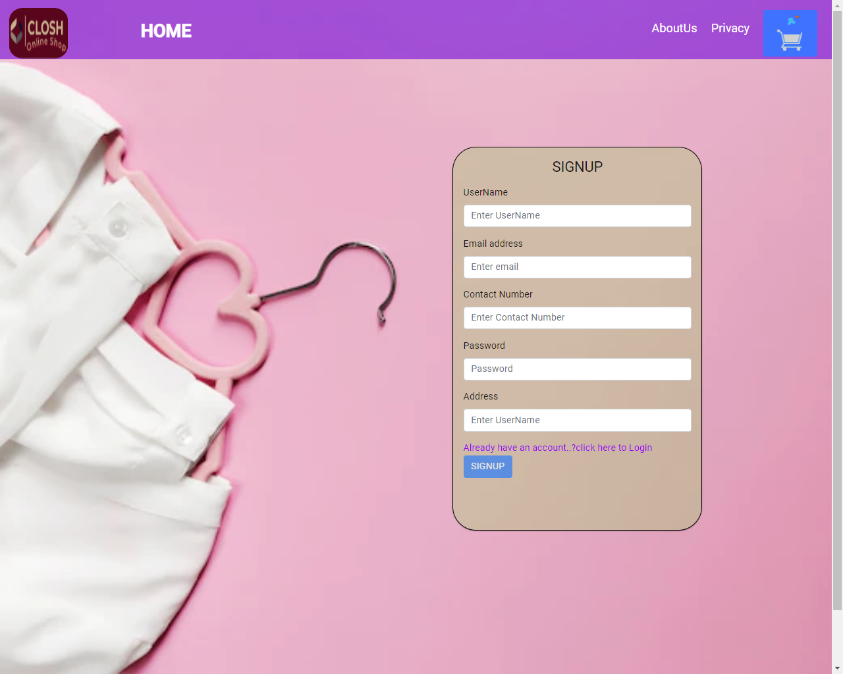
SignUp Page

Slide 10
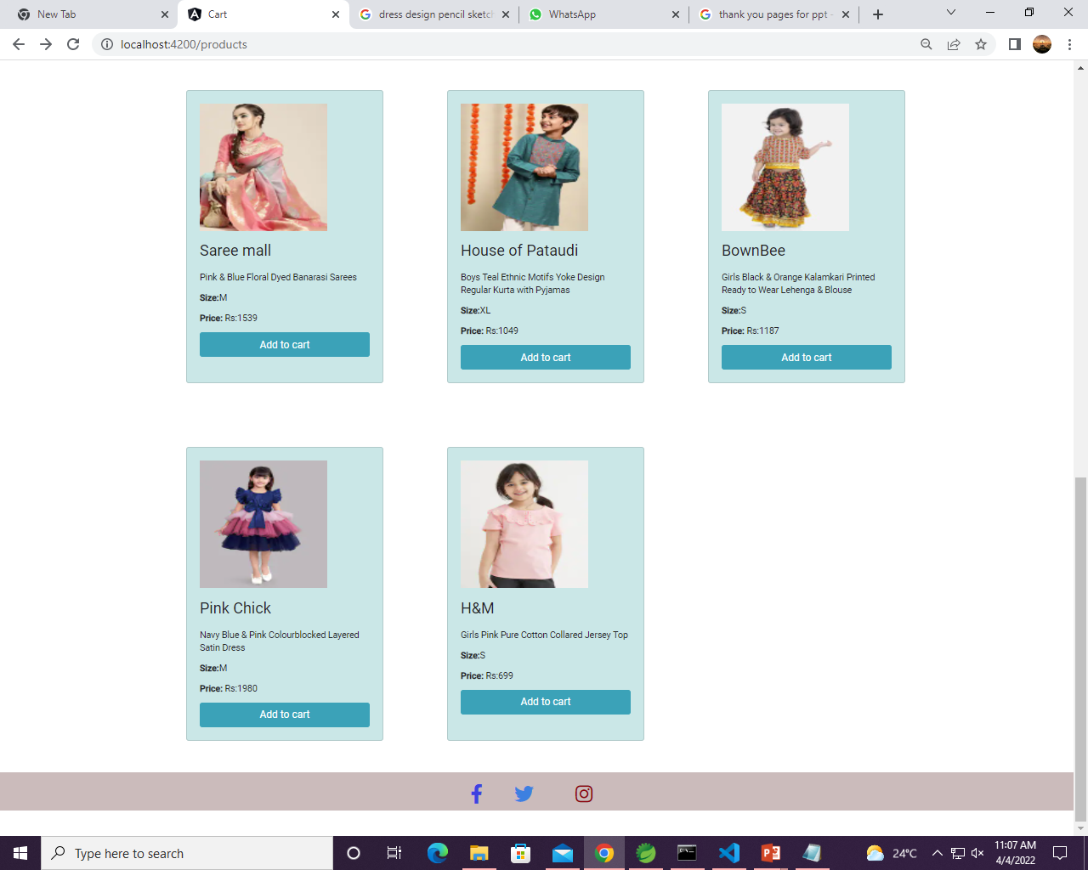
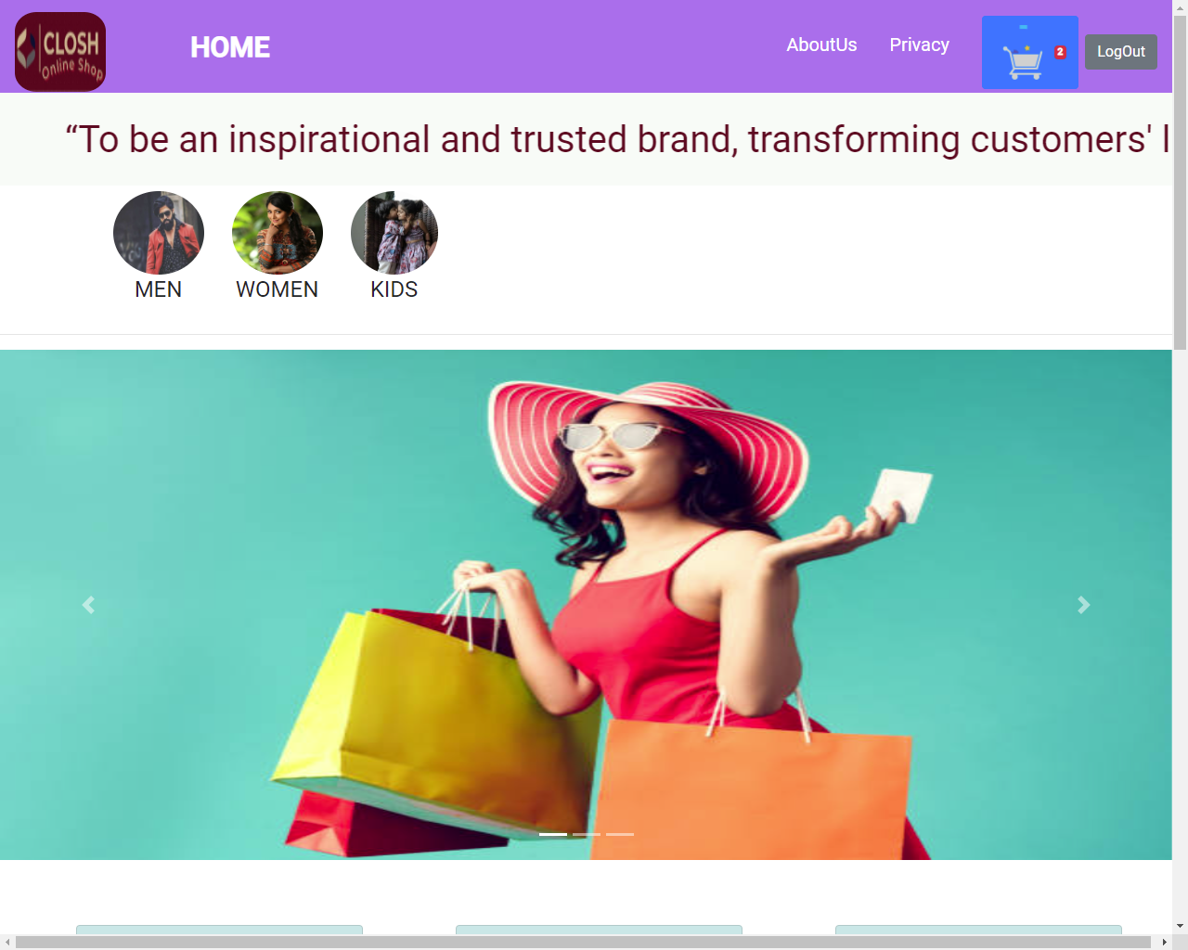
Home Page

Slide 11
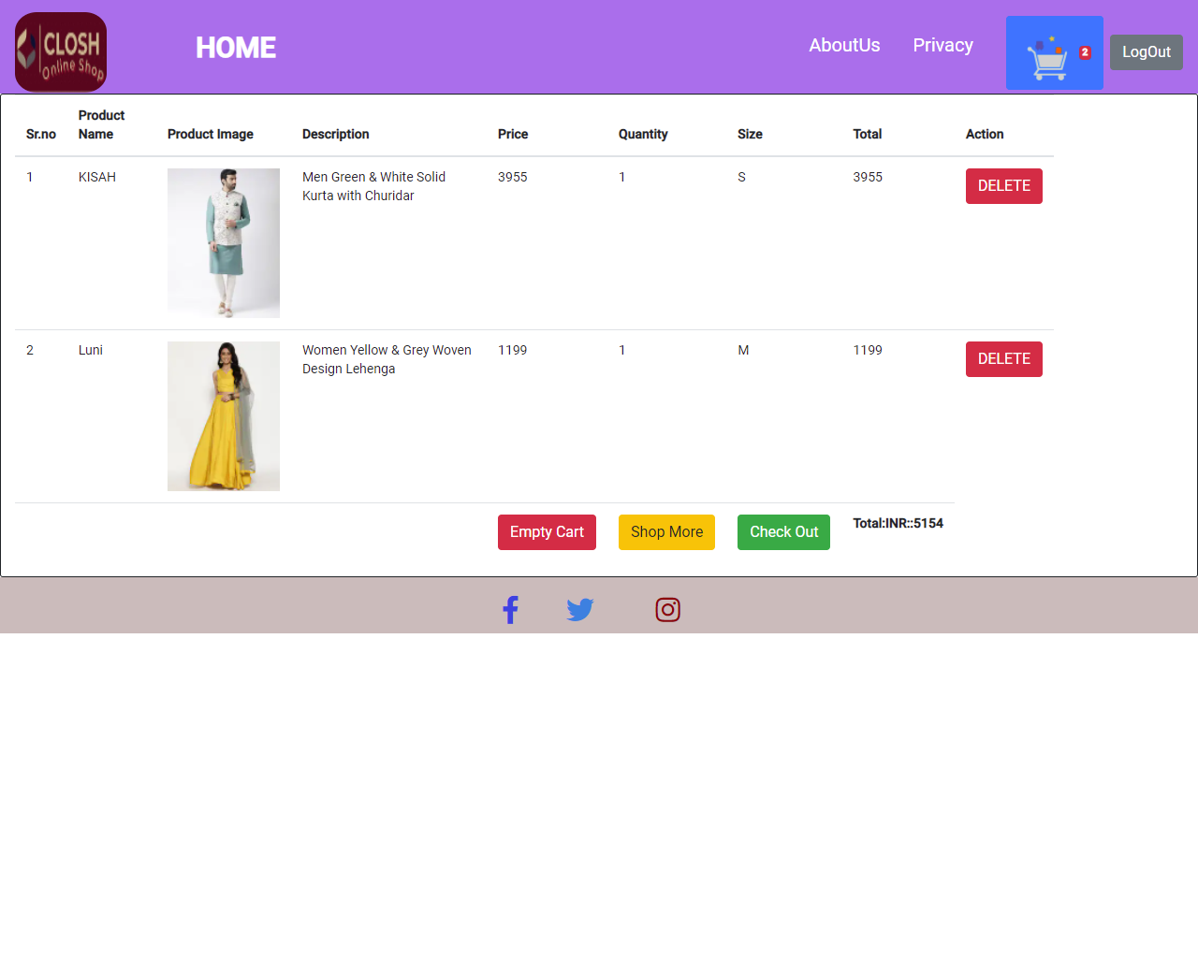
Cart Page

Slide 12
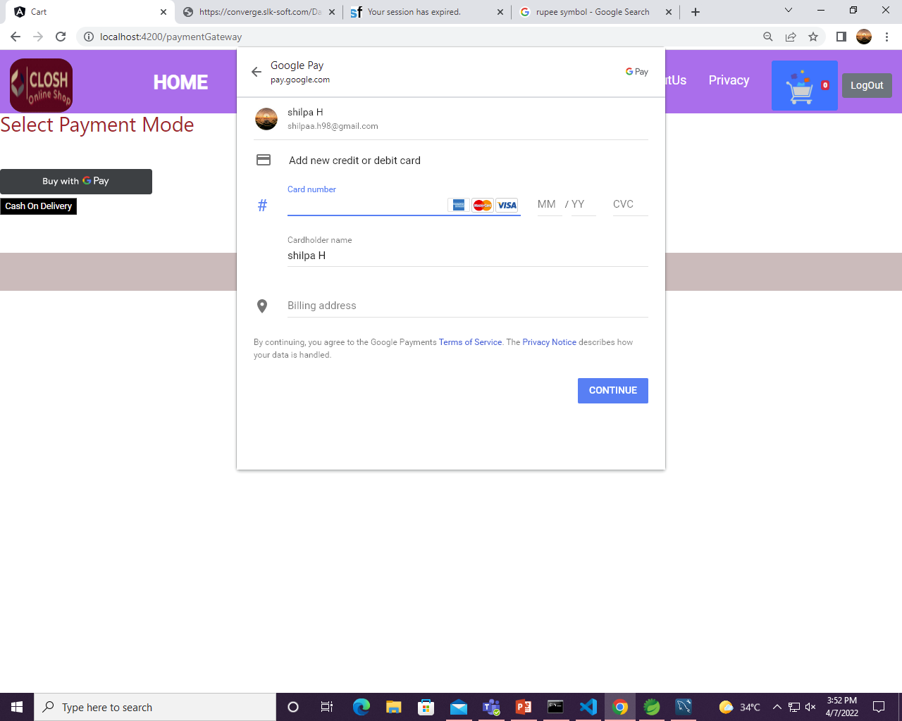
Payment Page

Slide 13

.

